Slide 1
The National Picture of Sibling Sexual Abuse
Stuart Allardyce and Anna Glinski

Slide 2
Introductions
Stuart Allardyce, Director, Stop It Now! Scotland / Lucy Faithfull Foundation
Anna Glinski, Deputy Director (knowledge and practice development), Centre of expertise on child sexual abuse

Slide 3
Looking after yourself – health warning
Sexual abuse can be difficult to think about and talk about. Thinking about it and talking about it will affect us all in different ways, at different times.
We know that a high number of people experience child sexual abuse and that many of them have never told anyone about it.
We can therefore assume that there will be people in this room today who have either experienced sexual abuse themselves, or who have a family member or friend who has been sexually abused – this may be their own child, a partner, a parent.
It is therefore important that we…
Be aware of the feelings and experiences of other delegates
Be kind to ourselves (personally and professionally)
Respect each other’s learning journey
Notes:
Be aware of the feelings and experiences of other delegates
Don’t make assumptions about whether, or how, other people have experienced things
Try not to engage in ‘othering’ language
Speak/type respectfully about victim/survivors of sexual abuse
Be kind to ourselves (personally and professionally)
If we need a break from the material, then we can do this by leaving the session
If we decide we can’t do this today, that’s okay
Expect some impact from the material – ‘a normal response to abnormal experiences’
Respect each other’s learning journey
There is no such thing as a stupid question – this is
the space to ask, clarify, discuss and get things wrong
Contribute to discussion – be brave!

Slide 4
Outline of session
Setting the scene
Prevalence
Causal factors
Understanding sibling relationships
Impact
Assessment
Intervention

Slide 5
Setting the scene

Slide 6
Definitions
Child sexual abuse “… involves forcing or enticing a child or young person to take part in sexual activities, not necessarily involving a high level of violence, whether or not the child is aware of what is happening. The activities may involve physical contact, including assault by penetration (for example, rape or oral sex) or nonpenetrative acts such as masturbation, kissing, rubbing and touching outside of clothing. They may also include noncontact activities, such as involving children in looking at, or in the production of, sexual images, watching sexual activities, encouraging children to behave in sexually inappropriate ways, or grooming a child in preparation for abuse. Sexual abuse can take place online, and technology can be used to facilitate offline abuse. Sexual abuse is not solely perpetrated by adult males. Women can also commit acts of sexual abuse, as can other children.”
(Department for Education, 2018:103)4
The RCEW National Project on Sibling Sexual Abuse uses, when appropriate, the following summary definition of sibling sexual abuse:
A form of harmful sexual behaviour or activity involving the misuse of power and victimising intent or outcome between children who self-identify as siblings.
Notes:
There is no universally accepted definition of sibling sexual abuse. This lack of consistency and clarity contributes significantly to the challenges in identifying the abuse with the risk that vague definitions will provide poor guidance to professionals.

Slide 7
Our recent report
Sibling sexual abuse is an issue that most protection practitioners will encounter at some stage in their careers.
This report provides an overview of the current research and practice knowledge into sibling sexual abuse.
It focuses on supporting practice, providing an accessible resource to help professionals understand the issues and challenges raised by sibling sexual abuse.
Notes:
It also gives confidence that, through the work that professionals do, the therapeutic goal of families healing and moving forward is possible.

Slide 8
A note on language…
The child who has harmed
The child who has been harmed
Notes:
In writing this paper we have paid close attention to the use of language throughout. Wherever possible we have used the phrases ‘child who has been harmed’ and ‘child who has harmed’ in preference to ‘victim/ survivor’ and ‘perpetrator’, in order to avoid the overtones of adult sex offending that these terms often convey. This is important because, from the 1980s onwards, research has conclusively shown that children and young people represent a population distinct from adults who commit sexual offences, and that pathways into – and out of – these behaviours are very different for children and for adults (Lussier and Blokland, 2014; McKillop et al, 2015).
There is now a large body of research evidence to support the view that children and young people who display harmful sexual behaviour are not ‘mini adult sex offenders’. Over the last 20 years, this has led to the development of practice approaches that recognise the importance of the developmental status of this client group. Many incidents involving sexual abuse perpetrated by children and young people are serious crimes, and proportionate management of the genuine risks that these individuals present is necessary. However, in accordance with the definition of childhood as set out in Article 1 of the United Nations Convention on the Rights of the Child (The United Nations, 1999), everyone under the age of 18 – including everyone who displays these behaviours – needs to be seen as a child first and foremost. Accordingly, where possible and not too cumbersome, we have avoided terminology that might imply that these behaviours parallel those of adults who commit sex offences.
Throughout the session today we will be using language which best describes the problem without labelling those involved. This is especially important when we are talking about children who have harmed. When we refer to children we will say “the child who has harmed”
In any discussions about child sexual abuse we think it is important to say what we mean. As such, we won’t refer to CSA or HSB but will say what we mean, child sexual abuse or harmful sexual behaviour

Slide 9
Prevalence

Slide 10
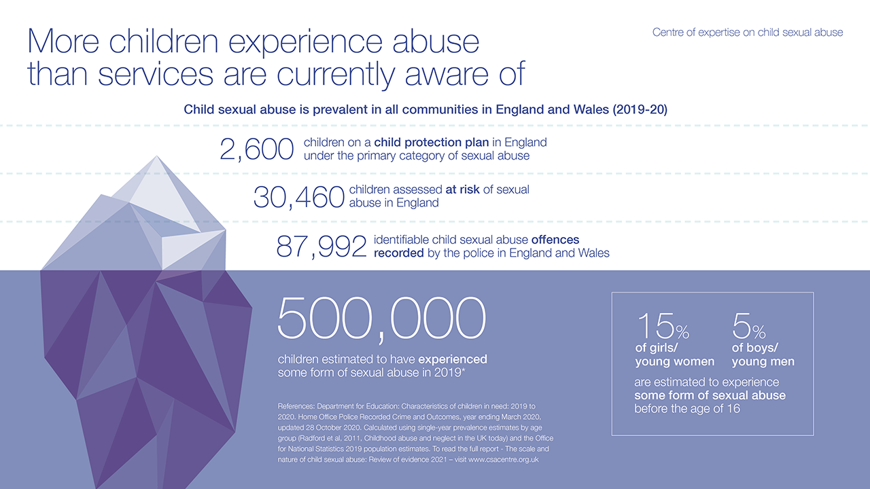
Notes:
The children experiencing sexual abuse that services know about is the tip of the iceberg.
Despite an estimated half a million children experiencing some for of child sexual abuse in 2019 the number of children that came to the awareness of children services and police is a fraction of that. The highest number feature in police recorded crime (however, about one-third of this is non-recent, i.e. occurred a year or longer before being uncovered/reported). This also includes CSA image offences (making up 26,809).
Far more children are experiencing abuse that we are aware of and responding to.
In this presentation I will focus on sibling sexual abuse, thought to be one of the most common forms of child sexual abuse.

Slide 11
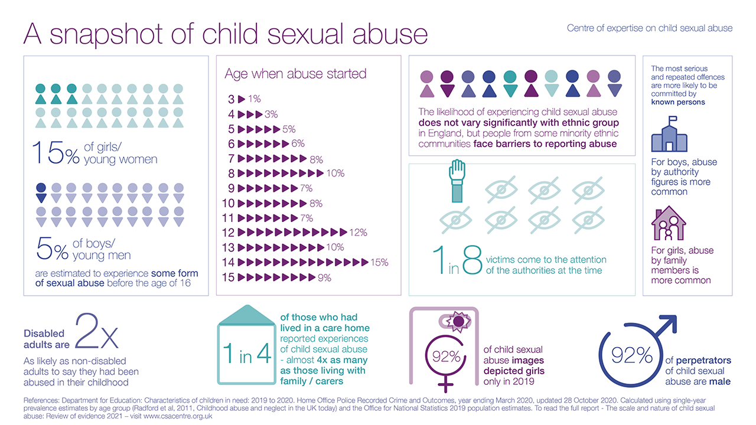
Notes:
If we look at national studies and survey data, we can see that:
At least one in ten children experience some form of sexual abuse before the age of 16.
Girls are at least three times more likely than boys to report experiences of child sexual abuse, with at least 15% of girls, and 5% of boys, experiencing some form of sexual abuse before the age of 16
The vast majority of people, 92%, who sexually abuse children are male.
Sexual abuse by siblings is estimated to be three times more common than abuse by a parent.
Boys are most likely to be abused by a friend or acquaintance and more commonly abused by authority figures than girls. For girls, they are most likely to be abused by family members.
We know that some adults are more likely to report experiences of child sexual abuse – disabled people are twice as likely as non-disabled people to report these experiences.
Children who live in residential care are four times more likely to say they were sexually abused than those living at home.
And, in almost all cases of child sexual abuse, the victim knows their abuser well. In almost two out of every five cases, they are a ‘friend or acquaintance of the victim or family member’, and in more than a quarter of cases, victims are abused by ‘another family member’.
As we will discuss later in these videos, most children and young people do not tell anyone at the time that the abuse is taking place, and many won’t speak about it until they are adults.
In surveys by the NSPCC and from national crime surveys we have gained more insight into this:
Five out of six people who said they had been sexually abused by another child had not told anyone about it, and for those sexually abused by an adult, one in three had not told anyone.
Children and young people, who do tell, are much more likely to tell friends or family than someone in a professional role.
And, we know that child sexual abuse does not vary significantly by ethnic group, but children from ethnic minority backgrounds are less likely to report abuse.

Slide 12
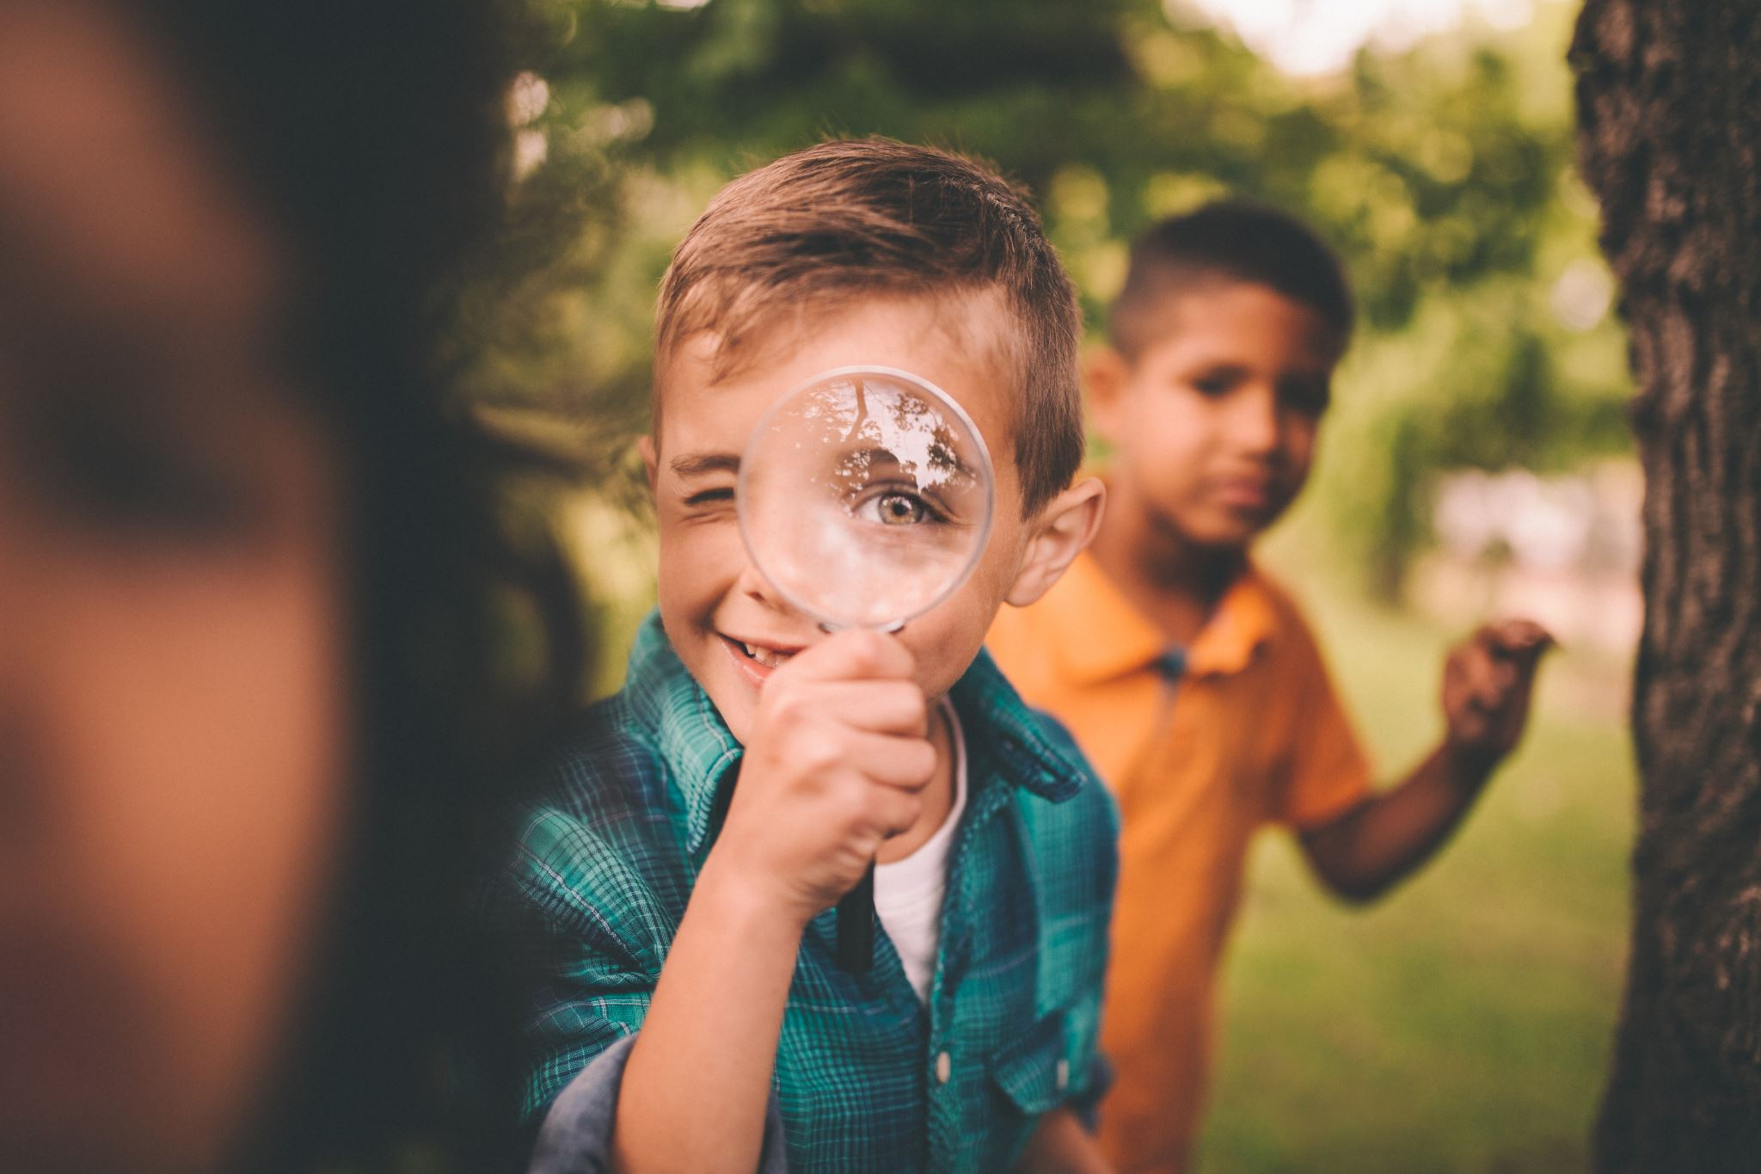
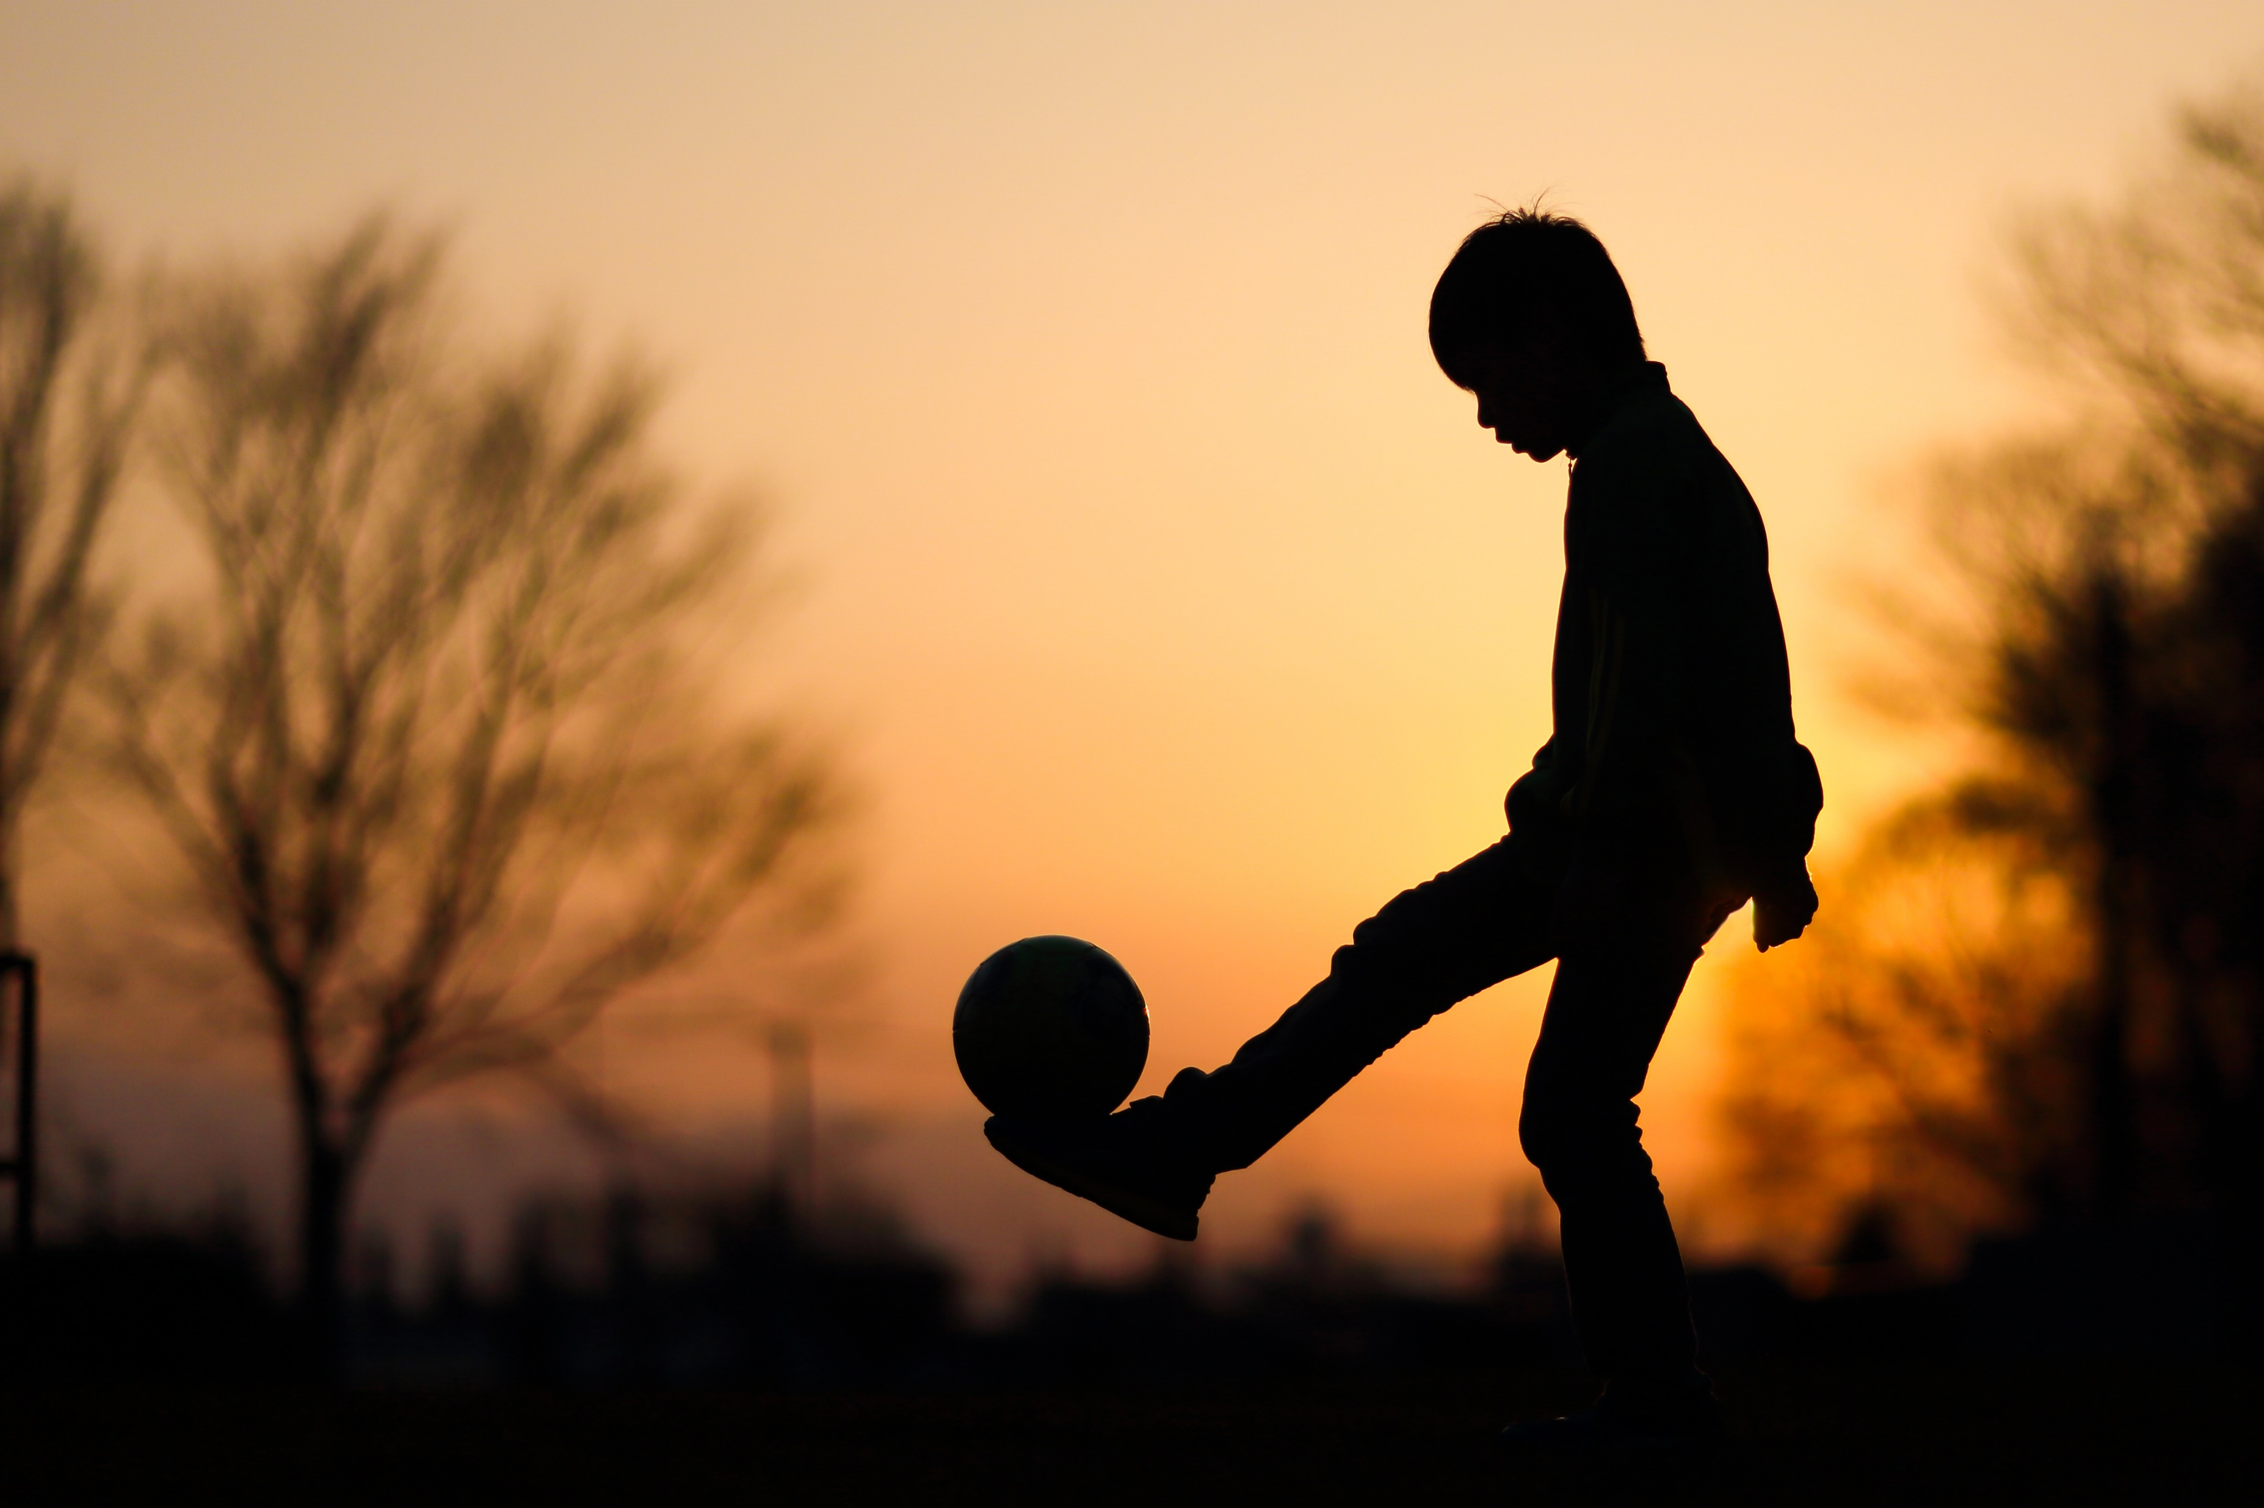
It’s not a rare phenomenon
15% of children may engage in sexual behaviour with their siblings, and around 5% may be involved in sibling sexual abuse
Estimated to be up to three times as common as sexual abuse by a parent
A recent Portuguese survey of university students found that 11% of males and 5% of females self-reported sexually coercing a sibling during their childhood
Notes:
There is no conclusive data on the extent of sibling sexual behaviour generally and sibling sexual abuse specifically. Different studies using different methods and definitions have produced different results. Some of the larger studies have found that somewhere in the region of 15% of children may engage in sexual behaviour with their siblings, and around 5% may be involved in sibling sexual abuse (e.g. Atwood, 2007; Finkelhor, 1980; Hardy, 2001), but it is not possible to give precise figures with confidence. A recent Portuguese survey of university students, for example, found that 11% of males and 5% of females self-reported sexually coercing a sibling during their childhood (Relva et al, 2017).
From the available data and the evidence regarding the comparative lack of disclosure of sibling sexual abuse, it is likely that this may be the most common form of intra-familial sexual abuse – estimated to be up to three times as common as sexual abuse by a parent (Krienert and Walsh, 2011; Stroebel et al, 2013).
It is therefore quite possible that any professional working in health and social care will encounter the issue, working either with children affected by sibling sexual abuse or with adult victims or survivors. All professionals working in health and social care must therefore be prepared to work with people affected by sibling sexual abuse, must understand its nature and consequences, and – where appropriate – must be able to assess and manage effectively different kinds of situations involving sibling sexual abuse

Slide 13
COVID19 and sibling sexual abuse: Areas of concern
Children and young people out of school
Children and young people lacking supervision – online and with siblings/family members
Increase in ‘self-generated’ images
Reduced protective services
Increase in parental stressors
Notes:
Stop It Now! helpline saw a 47% increase in calls from across the UK since start of lockdown
Calls from adults worried about a young person’s behaviour doubled since start of lockdown
The Internet Watch Foundation (IWF) is a child protection organisation that uses technology to find and remove child sexual abuse material from the internet.
In 2020, the IWF noted an alarming uptick in the volume of ‘self-generated’ material discovered online.
Within this, analysts observed a particularly disturbing trend of predators tricking children into involving other children in ‘self-production’.
Analysis of ‘self-generated’ sexual images reported to the IWF between September and December 2020 found:
511 images and videos involved siblings
65% of cases, one or both children engaged in direct sexual contact with the other
46% of this material was classified as Category A content, depicting the most severe forms of child sexual abuse
In many cases, children had been manipulated or coerced by adults into livestreaming sexual activity and the resulting videos and screenshots were shared across a variety of web platforms.
Some adults had posed as children, and occasionally the abuse took the form of a game or ‘dare’. The children involved rarely demonstrated any understanding of the sexual nature of
what they were being made to do.

Slide 14
Causal factors

Slide 15
The development of harmful sexual behaviours
The majority of young people who have sexually harmed others have been exposed to some form of maltreatment.
Neglect
Own experiences of sexual abuse
Inappropriate boundaries at home
Part of wider disruptive behaviour
Witnessing domestic violence
Parental experience of sexual abuse
Lack of supervision
Discontinuity of care
Jealousy of siblings
Learning disability
Notes:
Sibling sexual abuse is statistically associated with family environments characterised by disrupted living situations, poor family relationships, and unstable parental backgrounds
‣ Children who sexually abuse their siblings may often have experienced abuse and trauma themselves, and must be given support accordingly.
‣ This does not mean that sibling sexual abuse only takes place within the context of wider family difficulties – a child may have been abused outside the family and then re-enact this with their sibling, for example – but it does mean that both the sibling relationships and the wider family dynamics need to be explored in order to understand the pathway to sibling sexual abuse and to tailor appropriate interventions.
We know from Large scale pieces of research that the aetiology of HSB is complex and mulit-factorial.
Hackett (2013) – 66% had experienced some form of maltreatment.
Lalumiere (2010) – adolescents charged with an offence, 5x more likely to experienced sexual abuse than adolescents who committed a non-sexual offence.
Latzman et al 2011 – yp who sexually abuse siblings are more likely to have themselves experienced sexual abuse than other up who display HSB.
Yates (2012) study of 34 boys drew a distinction between those who had abused siblings and those who had abused outside of family environment, and both. No difference in history of CSA for sibling/community. But mixed were more likely to have experienced mulitip form of trauma, incl. sexual abuse and to have begun their abuse earlier. Boys in sibling only group were more likely to have been motivated to a use by intense feelings of jealour anger, and to have begun to abuse in adolescence.
While some caution is needed owing to the small sample size, this suggests that there may be two possible pathways into sibling sexual abuse:
‣ a trauma-related early onset route (where boys may be more likely to abuse both siblings and children in the community)
‣ a later-onset route related to power dynamics and sibling jealousy (where boys may be more likely to abuse only siblings).
Understanding these kinds of dynamics will have clear implications for risk assessment and for therapeutic responses in relation to the child who has harmed, the child who has been harmed, and the relationship between them.
Most studies of sibling sexual abuse focus on the characteristics of the child who has been harmed or the child who harms, to the detriment of exploring the relationship between them. Exploring this relationship will be important, both in understanding the causes and contexts of the abuse and in assessing the help the siblings may need to recover and restore a healthier relationship in the future. Yates (2018, 2020) found that social workers rarely considered the possibility that the quality of the sibling relationship might be a causal factor in the abuse, or that it might suffer as a consequence of the abuse. Often, therefore, decisions relating to sibling contact and living arrangements were made without considering their emotional impact upon either child.

Slide 16
Sibling sexual behaviour can be divided into three types
Normative sexual interactions between siblings
Inappropriate or problematic sexual behaviour involving siblings
Sibling sexual abuse
Notes:
Normative behaviour can be described as an information-gathering process between children of a similar age, size and developmental status, provided it meets all these criteria:
It is voluntary, light-hearted and playful.
It diminishes if the children are told to stop by an adult.
It is balanced by a curiosity to explore all sorts of other things in the child’s world

Slide 17
Understanding sibling relationships
“… below a threshold of being abusive, ordinary sibling squabbling, bickering and fighting may not be as indicative of the relationship as whether or not, in between the bickering and fighting, there are indications of warmth.”
(Sanders, 2004:80)

Slide 18
Understanding sibling relationships
Enduring
Involving complex power dynamics
Informed by a range of gendered and cultural differences.
Mostly taking place ‘backstage’, away from the gaze of adults
Can change over time
Notes:
Before we understand problematic or abusive sexual behaviour involving siblings – we first need to understand a bit about sibling relationships in general
Sibling relationships are complex, they influence development and psychosocial functioning in a way that is likely to have a significant impact. Research tells us that our sibling relationships often outlast all other relationships including those with friends, parents or partners.
As children, we may spend more of our free time with our siblings than with anyone else
If you want to understand the function of any family we really need to look beyond how children are cared for by their parents or carers and consider how all individuals within the family interact ; their roles and
statuses in different situations and contexts; relationships between the children in the family; the children’s understanding of those relationships; and the individual needs of each child within the family.

Slide 19
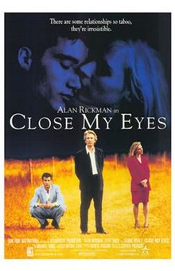
Cultural depictions of sibling incest
Notes:
Tend to be eroticised, transgressive, perhaps weird. But rarely traumatic.

Slide 20
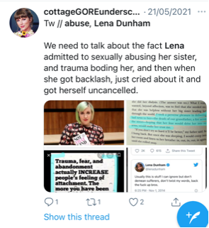
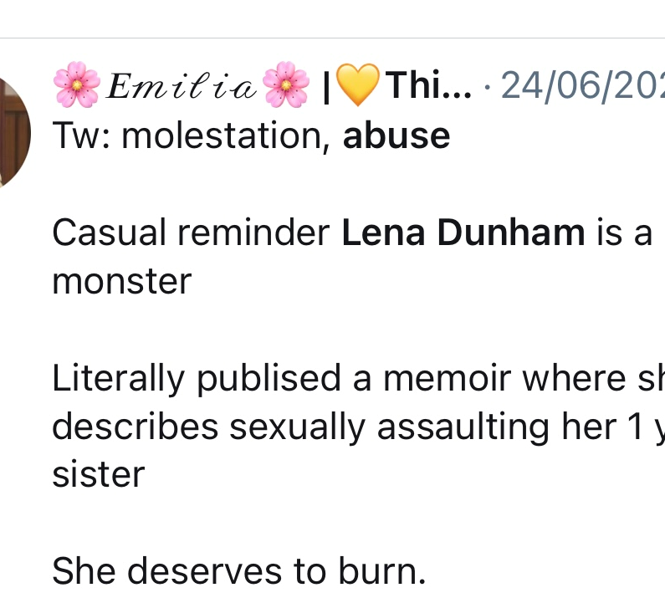
Cultural context - Lena Dunham
‘one day (when I was 7) as I sat in our driveway in Long Island with blocks and buckets my curiosity got the better of me. Grace (aged 1) was sitting up, babbling and smiling, and I leaned down between her legs and carefully spread open her vagina. She didn’t resist and when I saw what was inside I shrieked. My mother came running.. It quickly became apparent that Grace had stuffed six or seven pebbles in there. Mum mother removed them patiently which Grace cackled, thrilled her prank had been a success’

Slide 21
‘It was like a grenade going off in the family’

Slide 22
Case example 1
Hannah is 10 and lives with her mum and dad. Her stepbrother, Dylan is 13 and stays with them every weekend. Dylan’s mum has a difficult relationship with his father. Dylan’s father was charged with assaulting Dylan’s mum her on two occasions when they were together.
On a Sunday after Dylan has left and gone to stay with his dad for the week, Hannah tells her mum that her ‘flower’ is sore and there is blood when she goes to the toilet. When asked whether anything has happened she tells her mum that her brother has been coming into her bed on Friday and Saturday nights. He touches her between her legs and has shown her videos on his phone of people doing ‘naughty things’. He has tried to get her to do things in the videos and this last weekend tried to put his penis in her vagina. He has been coming to her room over the last 3 months.
Hannah’s mother is shocked and doesn’t know what to do. Hannah gets upset because she sees her mum is upset.
Notes:
What kinds of situations are we talking about here.

Slide 23
Case example 2
Josh is 9 and lives with his mum and dad and his 8 year old sister, Amy. His mum and dad have been arguing a lot recently and they have lots of financial problems after dad lost his job 6 months ago.
Josh and Amy share a bedroom. Mum and dad know that Josh sometimes crawls into Amy’s bed at night as they find them asleep together in the morning. The parents find this cute and have never discussed it with the siblings.
One night after bedtime they hear a noise from Josh and Amy’s bedroom. Dad goes upstairs and finds them both in bed together. He asks Josh to go to his bed. Josh is embarrassed and when he gets out of bed he has no pyjama bottoms on. Neither has Amy. He says that they have just been playing a game that makes them feel nice.

Slide 24
Understanding sibling sexual abuse
Less likely to be disclosed than other forms of sexual abuse
The most common reported pattern of sibling sexual abuse involves an older brother abusing a younger sister
Has the potential to be as harmful as sexual abuse by a parent
Entails a greater number of sexual acts over a longer period of time
May start at an earlier age and is more likely to involve sexual intercourse
May involve technology
The impact may not be apparent until adulthood
Notes:
So, what do we understand about sibling sexual abuse?
It is less likely to be disclosed than other forms of sexual abuse
ASK - Why is that?
Age differences
Power imbalance
Gender – particularly when family, culture or religion sanction women and girls as being of lesser status than men and boys. Taboos and silencing within certain cultures may present additional barriers to disclosure.
2) The most common reported pattern of sibling sexual abuse involves an older brother abusing a younger sister
But this is not the only form of SSA and doesn’t only refer to biological siblings
3) Has the potential to be as harmful as sexual abuse by a parent
Should not be minimised by professionals
4) Entails a greater number of sexual acts over a longer period of time (in comparison to other HSB)
Sexual acts may include a whole range of behaviours such as the touching of genitals, masturbation, oral sex, penetration with fingers and objects, anal and vaginal rape, and behaviours with an online element such as sharing pornography and self-produced sexual images.
5) May start at an earlier age (in comparison to HSB) and is more likely to involve intercourse
Lack of supervision
Remember – sibling relationships generally happen away form the gaze of adults
6) May involve technology
Incidents involving smartphones and the filming and sharing of incidents of sibling sexual abuse, as well as livestreaming of abuse, are new forms of harm being identified by practitioners and agencies.
5) The impact may not be apparent until adulthood
Back to point 1 (less likely to be reported)

Slide 25
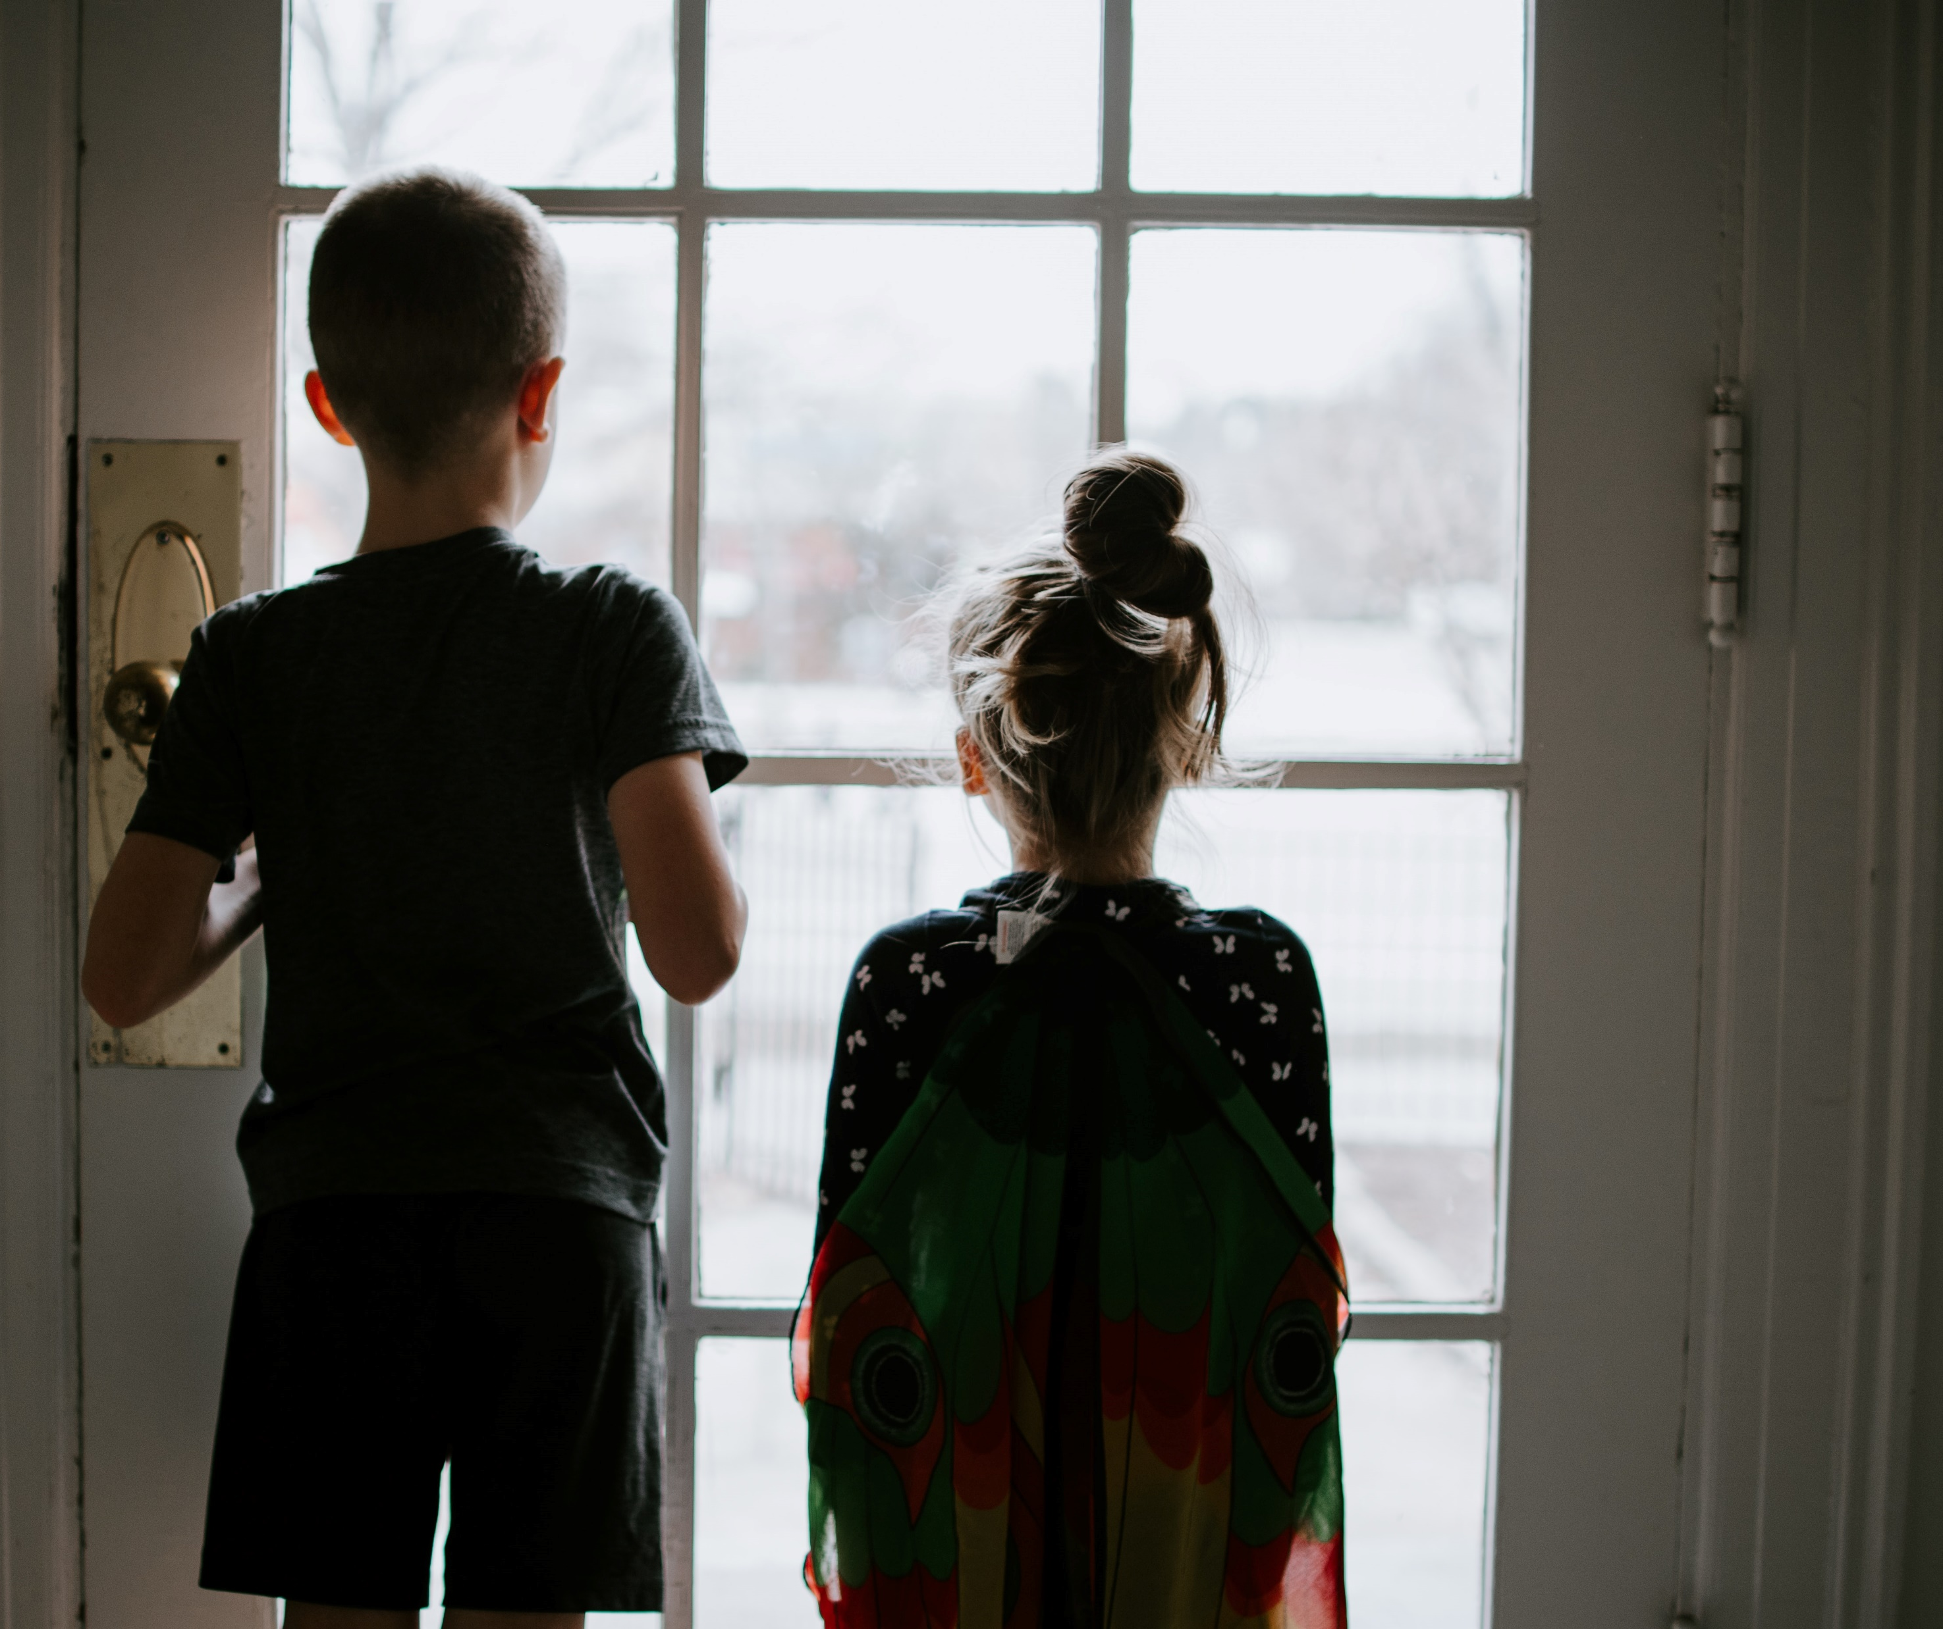
What else do we know?
Young people who sexually harm siblings are more likely than other young people displaying harmful sexual behaviour to have themselves been sexually abused
Non-abusive sibling sexual behaviour can escalate if left unchecked
Environmental factors, such as siblings of different ages and genders sharing beds or bedrooms, may also be significant

Slide 26
Sibling sexual abuse – a family issue
Sibling sexual abuse is statistically associated with family environments characterised by disrupted living situations, poor family relationships, and unstable parental backgrounds.
This does not mean that sibling sexual abuse only takes place within the context of wider family difficulties – a child may have been abused outside the family and then re-enact this with their sibling, for example – but it does mean that both the sibling relationships and the wider family dynamics need to be explored in order to understand the pathway to sibling sexual abuse and to tailor appropriate interventions.
Sibling sexual abuse must be understood as a problem of and for the family as a whole, and not just a problem for or about an individual child. The family as a whole needs to be involved in any intervention plan, and the strengths of the family – and potentially their community – must be harnessed in order to help them move on from harm.

Slide 27
Impact

Slide 28
Impact of sibling sexual behaviour
Potential to be just as harmful as parental abuse
Short and long-term impact: physical & mental health
Can lead to relationship difficulties throughout lifetimes
Impact may not be apparent until adulthood
Doesn’t equally affect all involved
Not acknowledging, or misplacing abuse, in a family can amplify the impact
Professionals must not make assumptions
Notes:
Sibling sexual abuse has the potential to be every bit as harmful as sexual abuse by a parent; it can have both short- and long-term consequences for children’s physical and mental health, and lead to relationship difficulties throughout their lifetime. The impact may not be apparent until adulthood.
As with other forms of child sexual abuse, sibling sexual abuse does not equally affect all those involved.
Families who do not acknowledge the abuse or who misplace responsibility can significantly amplify the abuse’s impact.
Professionals need to be careful not to make assumptions, but to assess the likely impact of sibling sexual abuse by considering its nature and duration, the context of sibling and family relations in which it has taken place, its meaning to the children involved, the responses of family members, and other protective and vulnerability factors.

Slide 29
Impact on family
Blame
Torn loyalties
Guilt
Distress
Anger
Jealousy
Notes:
Impact on the Family.
When we think about sexual abuse and its impact we often think about the impact of the abuse on the individual child – and as a result if we do anything with the family, we send the child off for individual intervention. Actually, what many survivors tell us is that they were able to recover from the physical instances of the abuse, but not the impact the abuse had on every family relationship.
When abuse has taken place it is an absolute corruption of family relationships – non-abusing parents who feel so guilty they can no longer offer their children physical affection; parents who are angry with one another for not protecting their child; the parent whose own parent or family member has abused their child feeling guilty, or being blamed by association by the other parent; siblings who may already feel jealous of the attention the victim was getting and who now can’t see the alleged perpetrator feeling angry with the victim; siblings feeling guilty about not recognising the abuse or stopping it if they were aware of it; siblings who were made to be the ‘lookout’. Many different ways in which family relationships are harmed significantly.
If we as professionals find it difficult to talk about sexual abuse, then we can pretty much guarantee that families won’t be talking about it either. We can be good at talking to children on their own, or talking to parents on their own, but we need to get better at facilitating them to talk to one another. So, for example, enabling a non-abusing parent to tell their child they didn’t know the abuse was happening (remember the abuser may have told the child their other parent knew), and that they are sorry.
As abuse has harmed family relationships, we need to support families to heal family relationships.
Families affected by sibling sexual abuse may feel
Out of control
Powerless
Fear
Anger
Anxiety
Guilt
Shame
Shock
Denial
Overwhelmed
Feeling like a failure
Loss
Grief
Confusion

Slide 30
How families may respond
Blaming the child who has been harmed
Denying anything happened
Blaming the other parent
Being unconcerned about the behaviour
Rejecting the child who has harmed
Taking no action
Notes:
Can be particularly traumatising if parents have their own experiences of sexual abuse

Slide 31
Families therefore need opportunities to make sense of the trauma of sibling sexual abuse if they are to be able to move on in a healthier way. Without sensitive and purposeful support, the impact of the abuse on sibling relationships and on other family relationships, whether maintained or estranged, can be lifelong.

Slide 32
Assessment and intervention

Slide 33
A road map
Initial assessment
Safety planning
Comprehensive assessment
Case closure / aftercare
Interventions

Slide 34
Comprehensive Assessment
Why has the young person behaved in a harmful sexual way?
How likely are they to do so again, to whom and in what particular circumstances?
What needs to be done in the short term to manage risks?
What are the indicators of risk increasing or decreasing?
What needs to be done in the longer term to reduce risks and to support prosocial development for the child who has harmed?
What will support and promote the child who has been harmed in terms of recovery from abuse?
How have other children or family members been impacted, and what do they need in terms of support?
How can the parents best support all children in the family?
How will progress be measured?

Slide 35
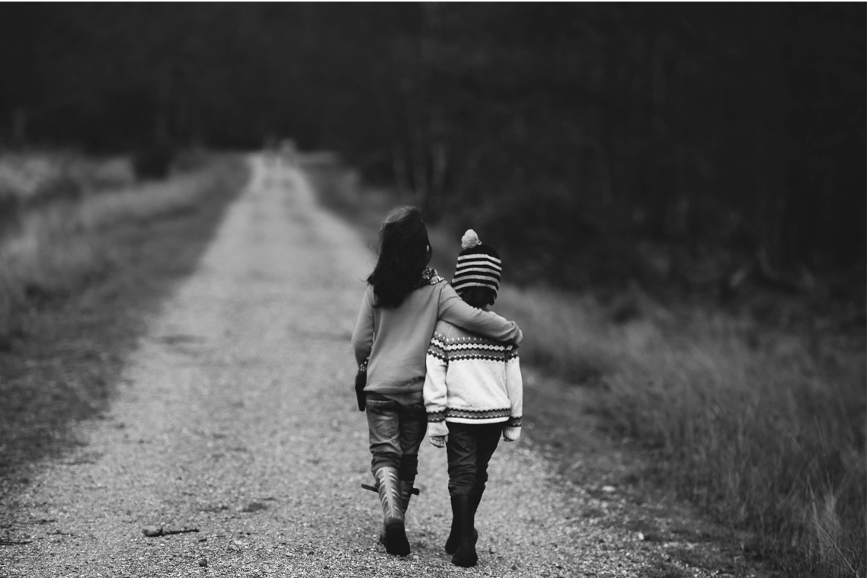
Assessment of sibling relationships
Patterns of closeness and attachment.
Alliances within the family: Emotional sharing and the role of secrecy and secrets between family members.
Changes in relationships over time.
Power dynamics: Who gets what and how in the family? What people do to tease, embarrass, reward, discipline, and punish within the family. Who is most commonly subjected to these behaviours and by whom?
How conflicts between siblings emerge and how they commonly end.
Horseplay within the family (tickling, playfighting etc.).
Roles siblings take on in the family.
Gender roles and stereotypes within the family.
Sexualisation: Does a sibling ever say anything that makes other siblings uncomfortable about their body? Do they ever get touched in ways they don’t like?
Cultural issues within the family.
Views about what needs to change in the future to promote emotional, physical and sexual safety.

Slide 36
Interventions
Ensuring safety
Supporting the child who has been harmed and any other children within the family
Helping the child who has harmed to move on from their behaviour
Repairing family relationships as a whole
Restoring family functioning
Restorative justice and family therapy models widely discussed in the literature and used in practice. Evidence base is limited but such approaches are congruent with nature of the problem.
Notes:
If you are a HSB provider you may wish to consider skills set / style of working

Slide 37
Reunification process
family assessment and evaluation
intervention planning
interventions with the child who has harmed and the child who has been harmed, to inform readiness for an initial meeting with each other
interventions with the parents to prepare them for a meeting between the siblings
a meeting between the child who has harmed and the child who has been harmed to promote the need for the former to accept responsibility (if appropriate) and answer questions that the latter may have ‣ further interventions with the children, and, if indicated:
supervised contact visits at the agency supporting the children
community contact visits
home visits
reunification
post-reunification services (e.g. DiGiorgio-Miller, 1998; Haskins, 2003; Thomas and Viar, 2005).

Slide 38
Key messages
Sibling sexual abuse must be understood as a problem for the whole family, not just for an individual child
Sibling sexual abuse has the potential to be as harmful as abuse by a parent
Close supervision of the professionals involved is essential
Young people who sexually harm siblings are more likely than other young people displaying harmful sexual behaviour to have themselves been sexually abused
Non-abusive sibling sexual behaviour can escalate if left unchecked
Families need opportunities to make sense of the trauma of sibling sexual abuse if they are to be able to move in a healthier way

Slide 39
‘Over time and with the right kinds of support, however, an experience that may be one of the most catastrophic any family can live through may also become a window of opportunity through which positive growth and change become possible’

Slide 40
If you are affected by anything that has been discussed today…
The Survivors Trust
Find help, support and advice in your area: Survivors Trust directory of services.
Rape Crisis helpline 0808 802 9999
www.rapecrisis.org.uk
National Association for People Abused in Childhood 0808 801 0331
https://napac.org.uk/
SurvivorsUK
Online help for male survivors of sexual abuse and rape.
https://www.survivorsuk.org/ways-we-can-help/online-helpline/

